Slide 1

Exploratory Data Analysis

Slide 2
Agenda
Exploratory Data Analysis(EDA)
What is EDA?
Where we use EDA?
EDA Methods
Examples of EDA

Slide 3

Exploratory Data Analysis(EDA)
To Identify Mistakes ( Missing values ,Empty values)
To guess what actually happened(Test assumptions)
To identify odd values (Outliers)

Slide 4
Exploratory Data Analysis(EDA)
To get a General sense of data(Mean , Median ,Quantiles)
To determine relationships among the explanatory variables(Draw patterns through visualization)
Discover hidden patterns(Data mining)

Slide 5

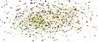
To Summarize EDA is:
Wrapped Data
First step in analyzing data from an experiment.
EDA

Slide 6
To Summarize EDA is:
Bringing important aspects of that data into focus for further analysis.
Looking at your data set from many angles and describing it, without making any assumptions about its contents.
Wrapped Data
EDA

Slide 7

Why EDA ?
A preliminary exploration of the data to better understand its characteristics.
Helping to select the right tool for Preprocessing, Data Analysis And Data Mining

Slide 8

EDA: Explore Data & Recognize Pattern
Explore a data set
Understand the events that generated the data
To help you see what happened, sometimes in spite of your expectations

Slide 9
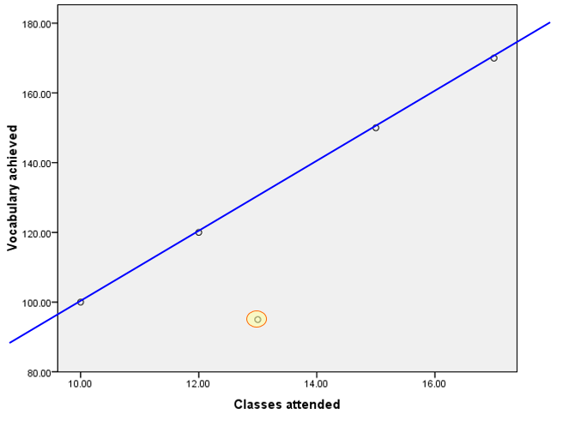
A Simple Example
Class Attendance and Words Learning
Ram: 10 classes; 100 words
Pogo:15 classes ; 150 words
Dev: 12 classes; 120 words
Sita: 17 classes; 170 words
Logo: 13 classes; 95 words
Positive Correlation
Outlier

Slide 10

Where we use EDA ? : ML & Stats
EDA is a significant step to take before diving into Machine learning or Statistical modeling

Slide 11
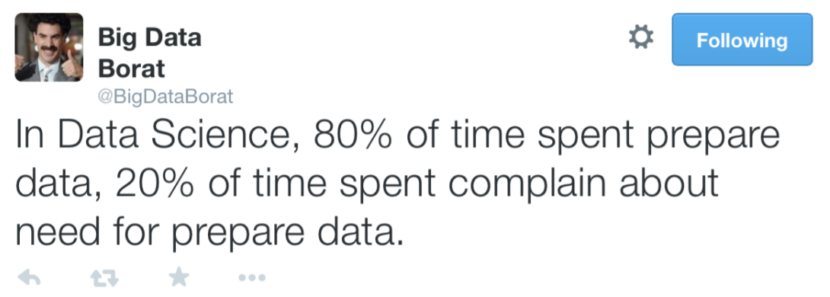
Where we use EDA ? : Data Science

Slide 12

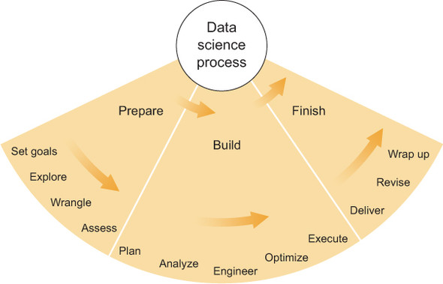
Where we use EDA ? : Data Science
EDA

Slide 13
EDA Methods
EDA
Graphical
Non-Graphical

Slide 14
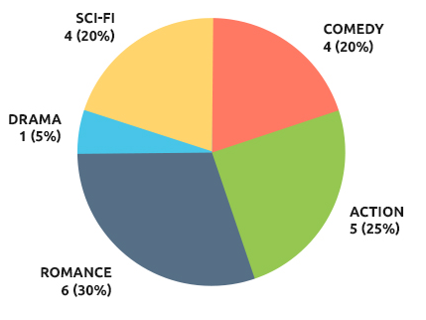
Data Relationship through Graphs : Visualization
My Movie Choice

Slide 15

Non-Graphical : Summary Statistics
Summary statistics are numbers that summarize properties of the data
Central Tendency ( Middle Values)
Mean
Median
Mode
Variation (or Summary of Differences Within Groups)
Range
Interquartile Range(IQR)
Variance(σ² )
Standard Deviation (σ)

Slide 16
Five Number Summary
A Convenient way to represent a distribution with a few numbers
Statistics included
Minimum score
The first quartile
The median (second quartile)
Third quartile
Maximum score
*Note : Best way to show Five Number Summary is via box plot

Slide 17
A Simple Example
Marks(50) : 17,41,45,22,22,8,10,33,38
Arranged values : 8,10,17,22,22,33,38,41,45
Minimum=8 Q1=17
(First Quartile)Q1=17,
(Third Quartile)Q3=38
Maximum=45
IQR(Q3-Q1) = 21
σ: 12.786953227392
Range = 37
Mean = 26.22
Mode = 22
Median = 22

Slide 18

A Simple Example : Age Survey in a society
A Simple Example
Data :0-10 : 12 ,10-20 :10 ,20-30:15,30-40:32,40-50:28,50-60:19,60-70:10,>70:5.0-10:-3,30-40:32

Slide 19
Create a Table for better information
A Simple Example
Age | Frequency
0-10 | 12
10-20 | 10
20-30 | 15
30-40 | 32
40-50 | 28
50-60 | 19
60-70 | 10
>70 | 5
0-10 | -3
30-40 | 32
Duplicate Values
Age can't be negative

Slide 20
Create a Table for better information
A Simple Example
Age | Frequency
0-10 | 12
10-20 | 10
20-30 | 15
30-40 | 32
40-50 | 28
50-60 | 19
60-70 | 10
>70 | 5
0-10 | -3
30-40 | 32
Age | Frequency
0-10 | 12
10-20 | 10
20-30 | 15
30-40 | 12
40-50 | 28
50-60 | 19
60-70 | 10
>70 | 5
Duplicate Values
Age can't be negative

Slide 21
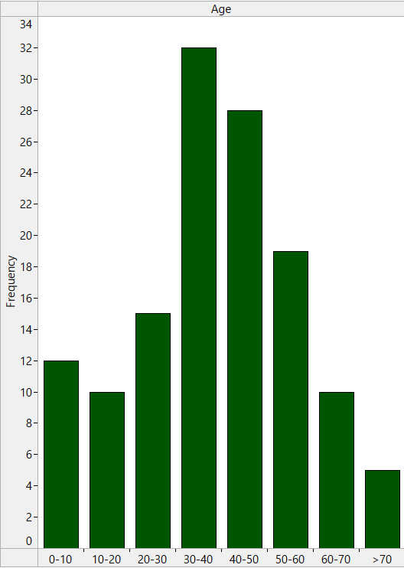
More Easy Approach : Relative Frequency Histogram
A Simple Example
Lose no richness in the data
Easy to reconstruct data set
Allows you to spot oddities

Slide 22

Lets Learn More about Graphical EDA

Slide 23
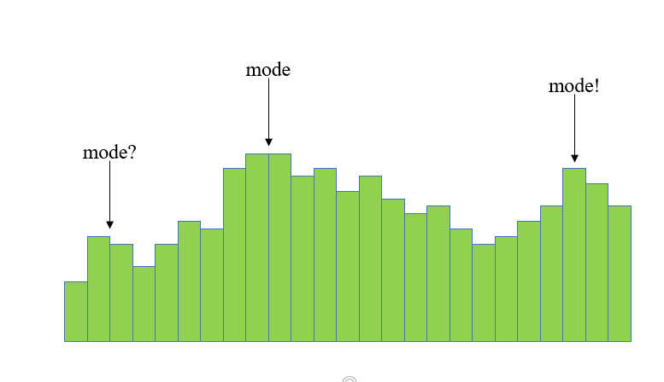
Histograms
Useful for illustrating the shape of the distribution of a batch of numbers
Above is clearly bimodal
May be multimodal…

Slide 24
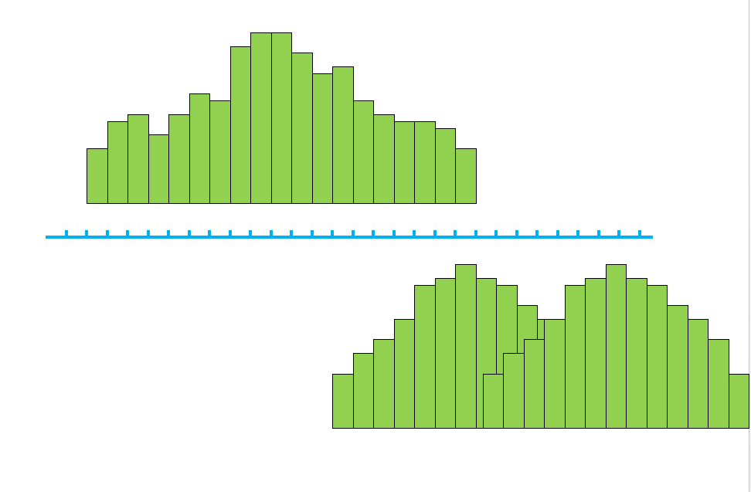
Histograms

Slide 25

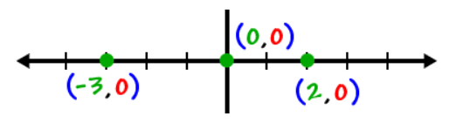
Real Zeros
A real zero is where a graph crosses or touches the x-axis.
Putting y=0 , we can find real zero points.
real Zero points

Slide 26
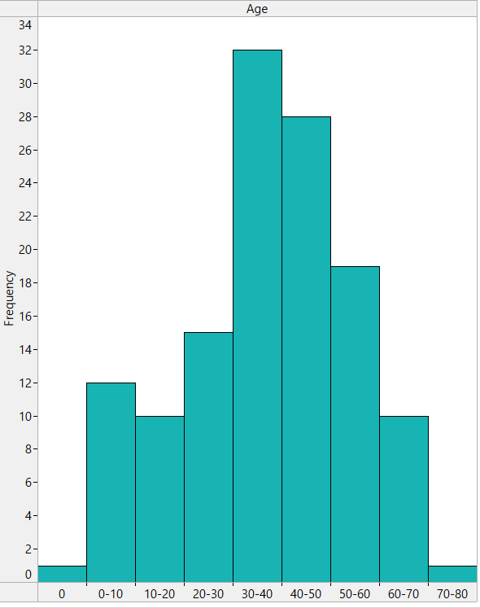
Real Zeros
real Zero
Not real Zero

Slide 27
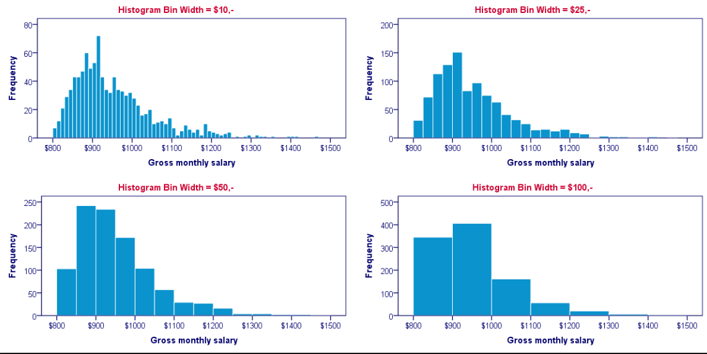
Histogram with different bin width
Outliers, or strange patterns.
Bin width and position matter
Beware of real zeros
Careful about Y-axis Scale
Not real Zeroes

Slide 28
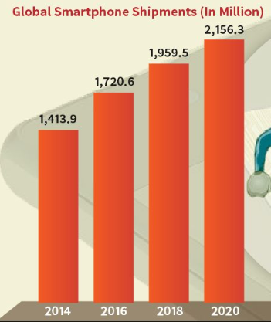

Univariate : Single Variable
P.C : Global Industry Analysts Inc,USA

Slide 29
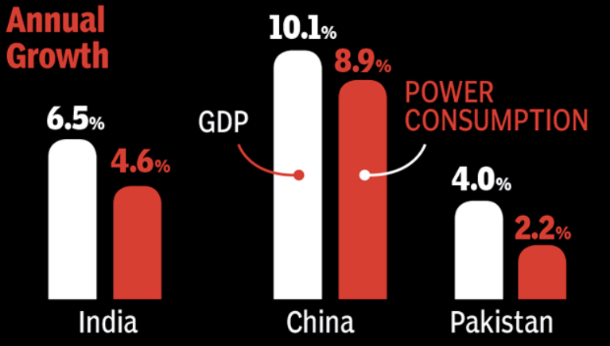
Multivariate : Two or more Variables
Variable-1
Variable-2

Slide 30
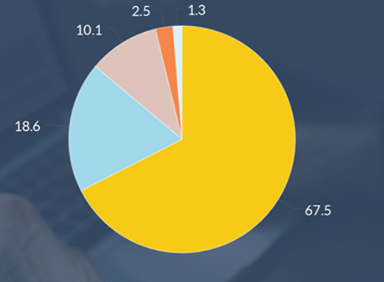
Pie Charts: Where you Search in Internet?
Google
Bing
Yahoo
Ask
Others
Good for comparing popularity of each category

Slide 31
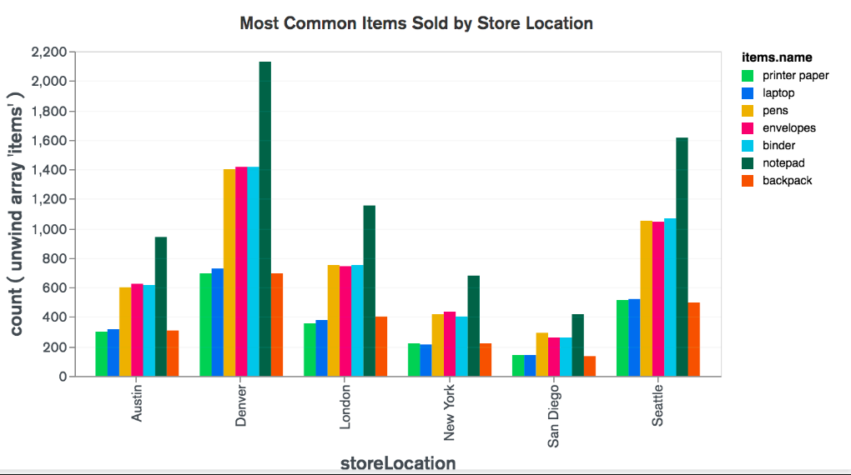
Bar charts
Barcharts can be used to compare continuous values across two or more categorical ones(Stacked).

Slide 32
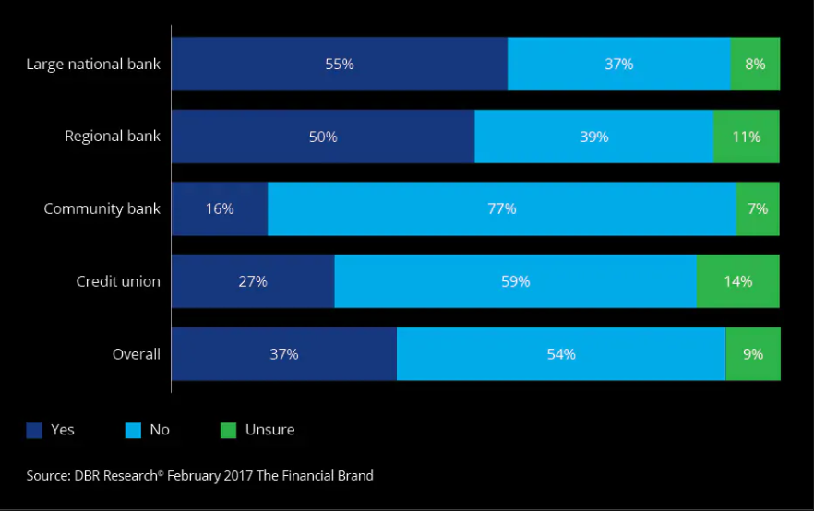
Stacked Bar charts : 2018 banking Industry Outlook

Slide 33
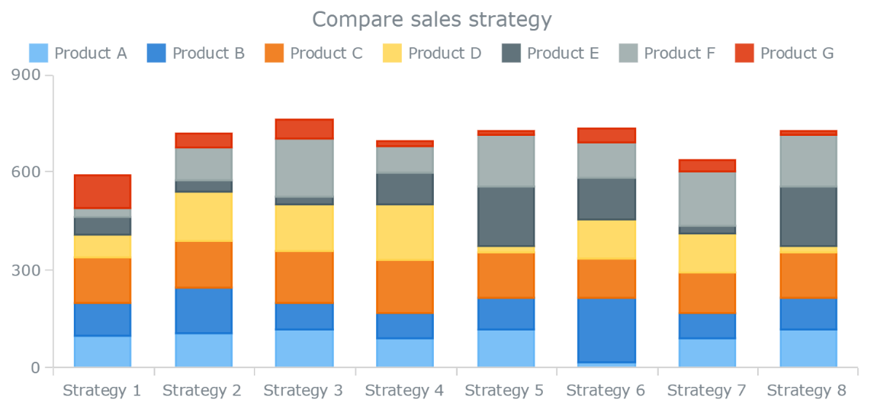
Stacked bar charts : Company Sales Strategy

Slide 34
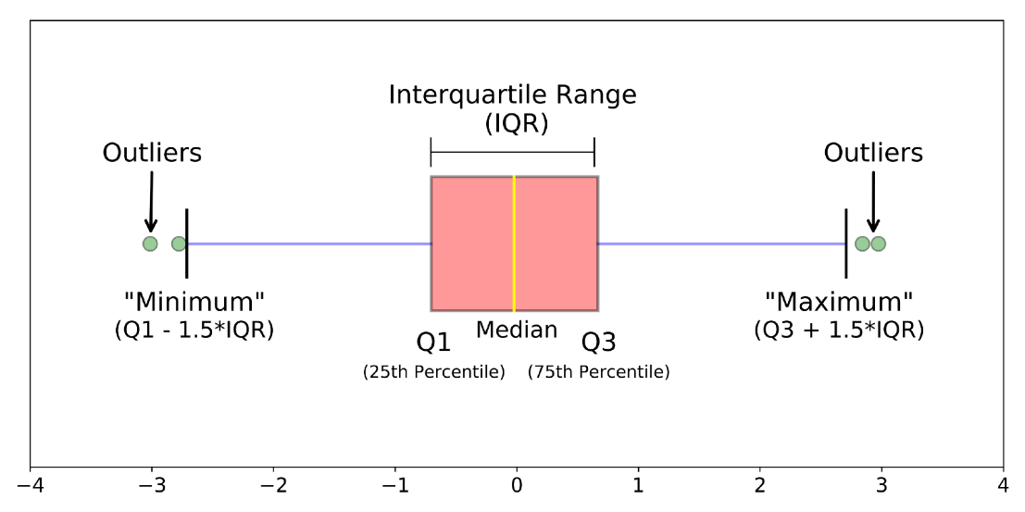
Box Plots
Shows a lot of information about a variable in one plot
Median
IQR
Outliers
Range
Skewness
Negatives
Over plotting
Hard to tell distributional shape
no standard implementation in software (many options for whiskers, outliers)

Slide 35
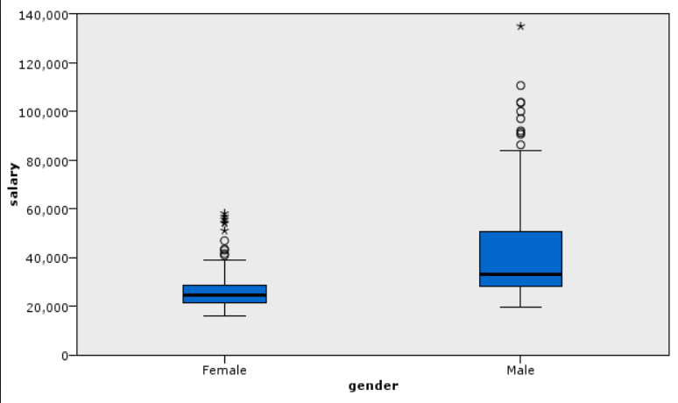
Box Plot : Salary Distribution in a company
Outlier

Slide 36
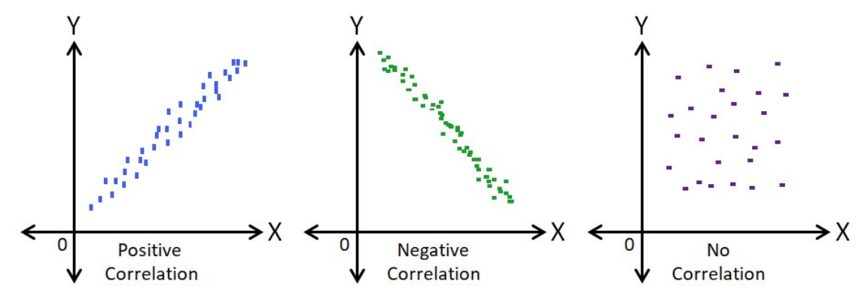
Scatter Plot
Shows Relationship between sets of data

Slide 37
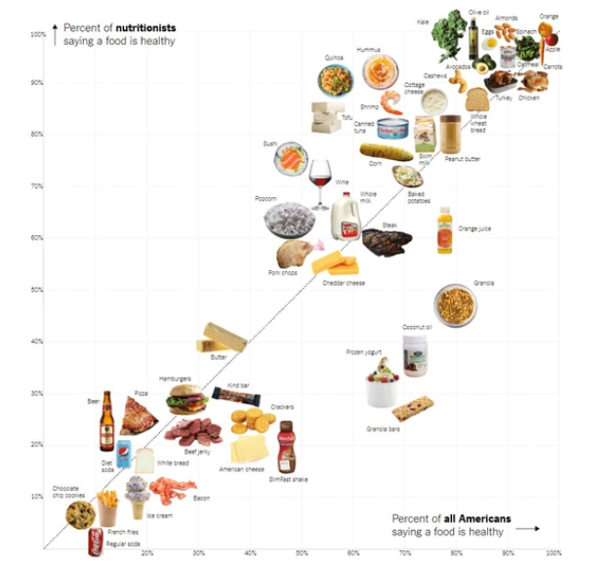
Scatter Plot : Healthy food(Nutritionist Vs Public)
Nutritionist
Heathiest
Unhealthiest
Public

Slide 38
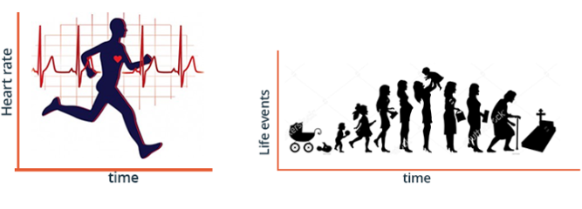
Time Series Graph
Time ordered data
Predict Changes in business or economy
See for seasonal patterns

Slide 39
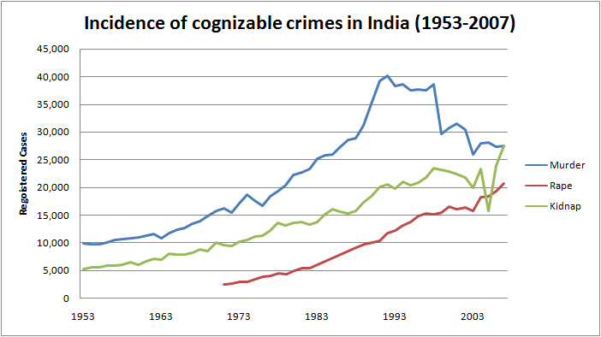
Time Series Graph : Crime Trends in India
Increasing
Decreasing
Almost Constant
PC : Wikipedia

Slide 40
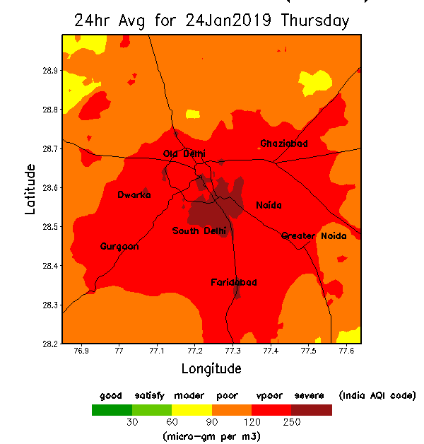
Spatial Data Graph
Data has a geographic component
Get latitude/longitude for Spatial Data
E.g. : Air Pollution in Delhi

Slide 41
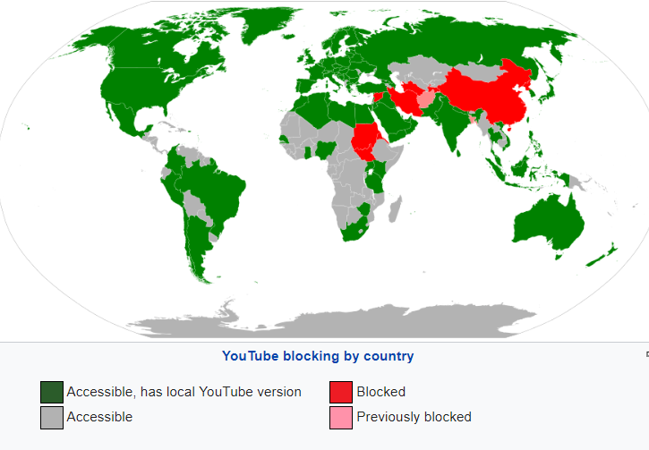
Spatial Data Graph: You Tube Blocking by Country

Slide 42
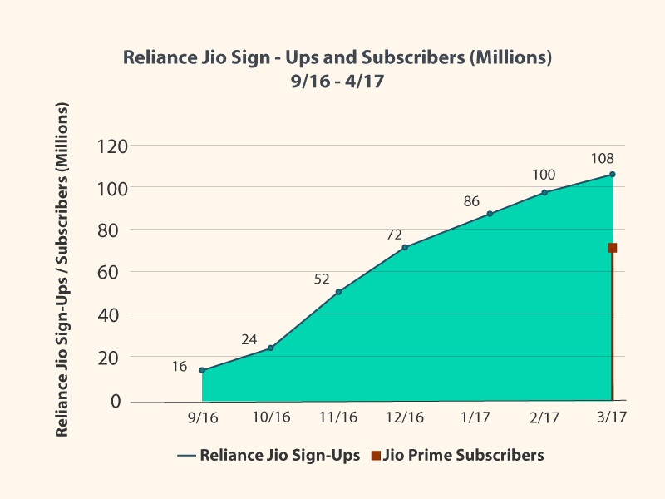
Area Charts
Displays graphically Quantitative data. It is based on the line chart.

Slide 43
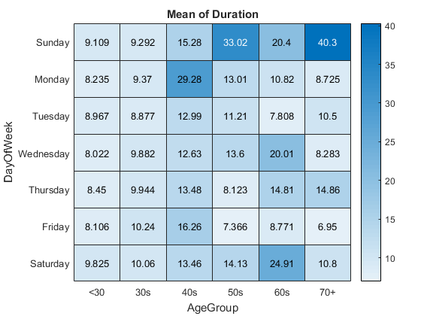
Heat Map
A two-dimensional representation of data in which values are represented by colors.

Slide 44
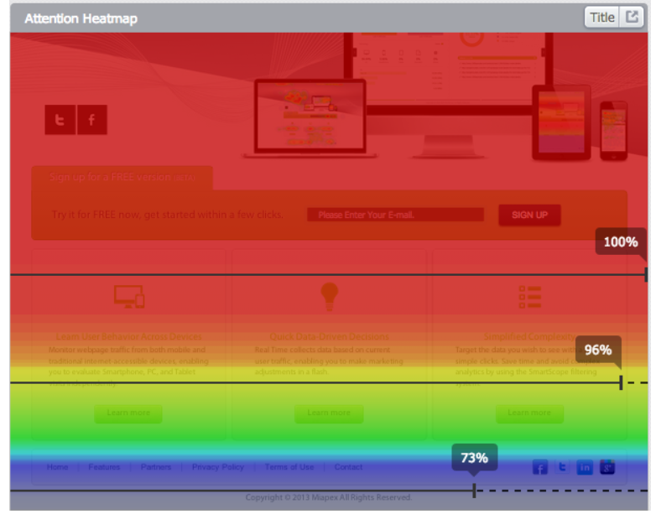
Heat Map as Attention mapping
Attention mapping
Uses the customer's browser data to display which part of the page received the most attention

Slide 45
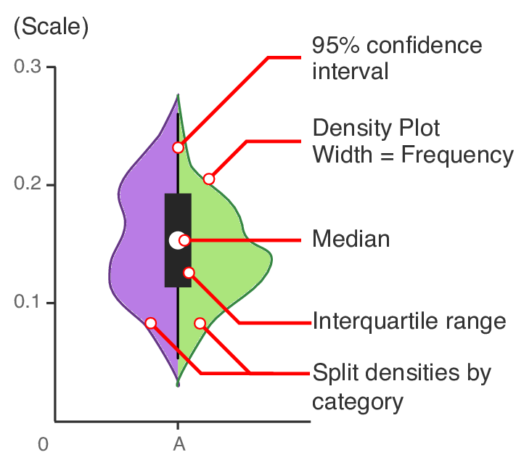
Violin Plot
A violin plot is a method of plotting numeric data.
It is a combination of a box plot with a rotated kernel density plot on each side.

Slide 46
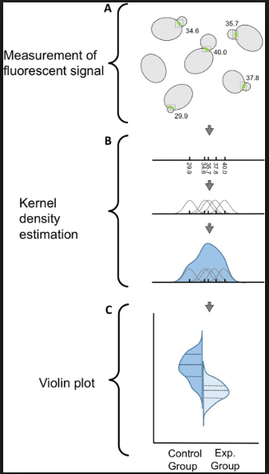
What is Kernel density ?
Kernel density estimation (KDE) is a non-parametric way to estimate the probability density function of a random variable.
Kernel density estimation is a fundamental data smoothing problem .

Slide 47
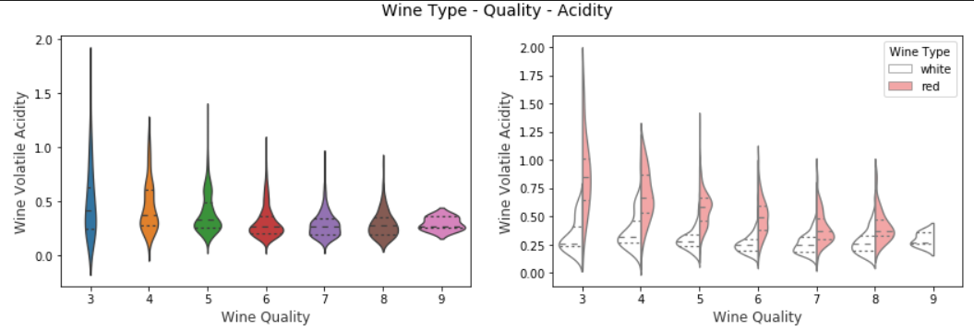
Violin Plot

Slide 48
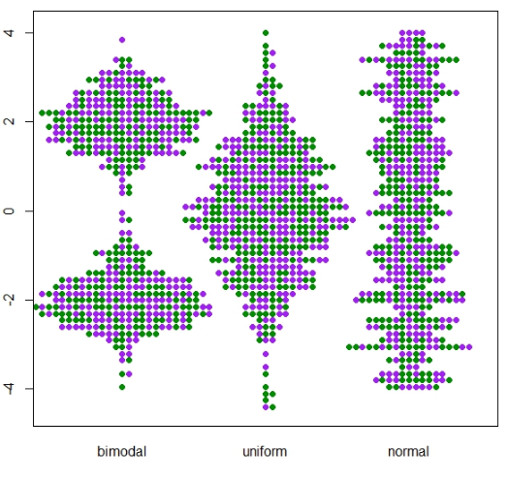
Swarm plot
Way of showing data distribution among different variables.

Slide 49
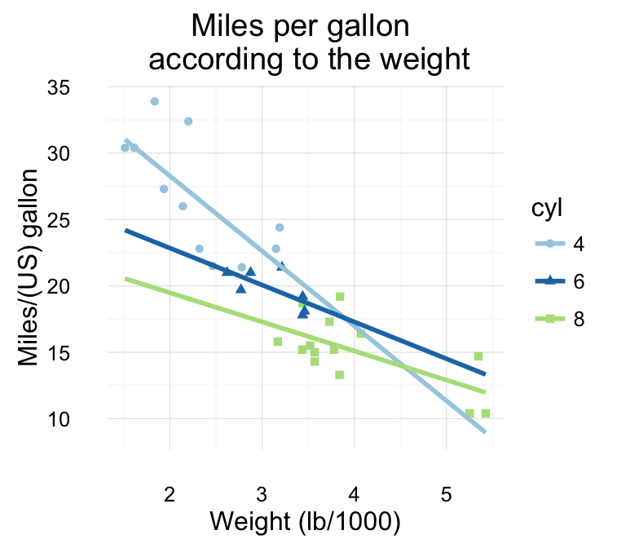
Factor Plot
A factor plot is simply the same plot generated for different response and factor variables and arranged on a single page.

Slide 50

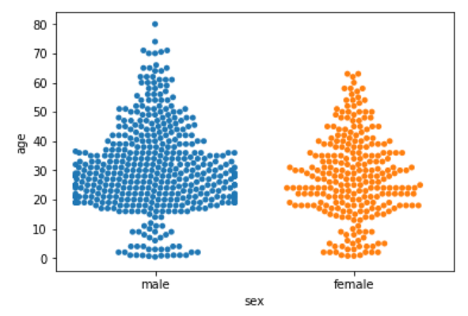
Swarm plot :Male female age distribution in a office

Slide 51
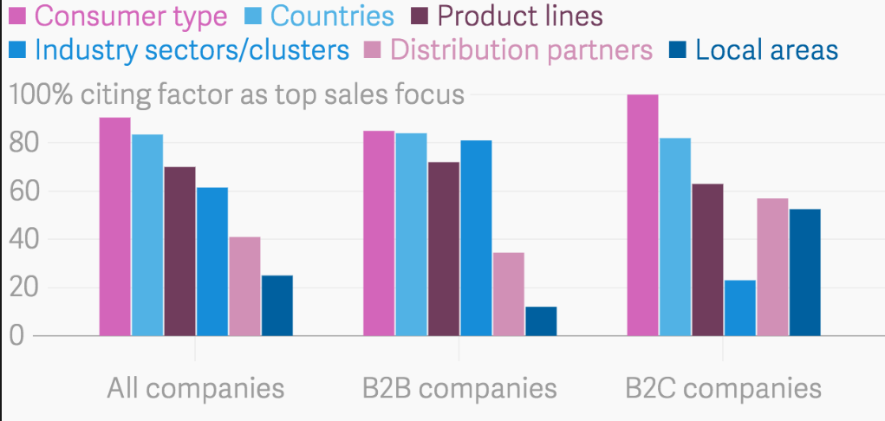
Factor plot : Top Sales focus(different company type)

Slide 52
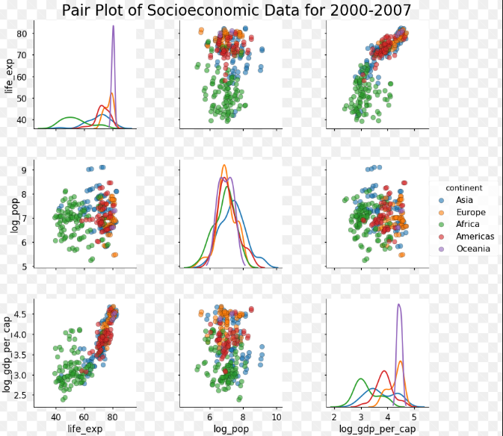
Pair Plot
A Simple 2D Scatter plot is used to understand the relationship or pattern when two or more variables our dataset
E.G : Plot of Socioeconomic Data For 2007-2014 (Continent wise)

Slide 53
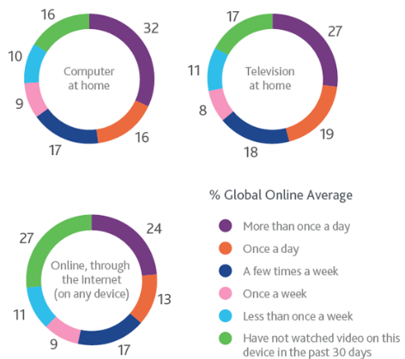
Doughnut Plots
The doughnut chart is a variant of the pie chart with area of center cut out.
Are more space-efficient than Pie Charts because the blank space inside a Donut Chart can be used to display information inside it.
E.G : How often you watch video content in mentioned devices in past month.

Slide 54
Which graphs to choose ?
Quantitative Line graph across time 1 variable: Histograms, Boxplots, Quantile normal plot 2 variables: Scatterplots | Categorical 1 variable: Pie charts, Bar graphs 2 or more: Bar graphs, Pictograms, Contingency Tables
Categorical & Quantitative: Boxplot

Slide 55
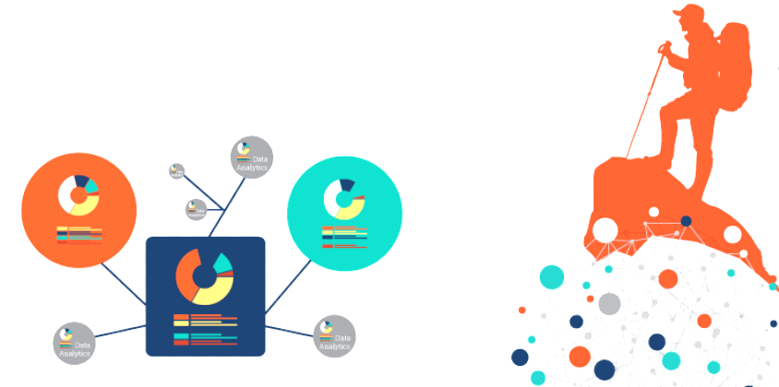
To Conclude
EDA is first step to turn data into Information ( via Graphical or Non-Graphical methods.)

